Slide 1
Chirag
BS Mathematics, 4th Year

Slide 2
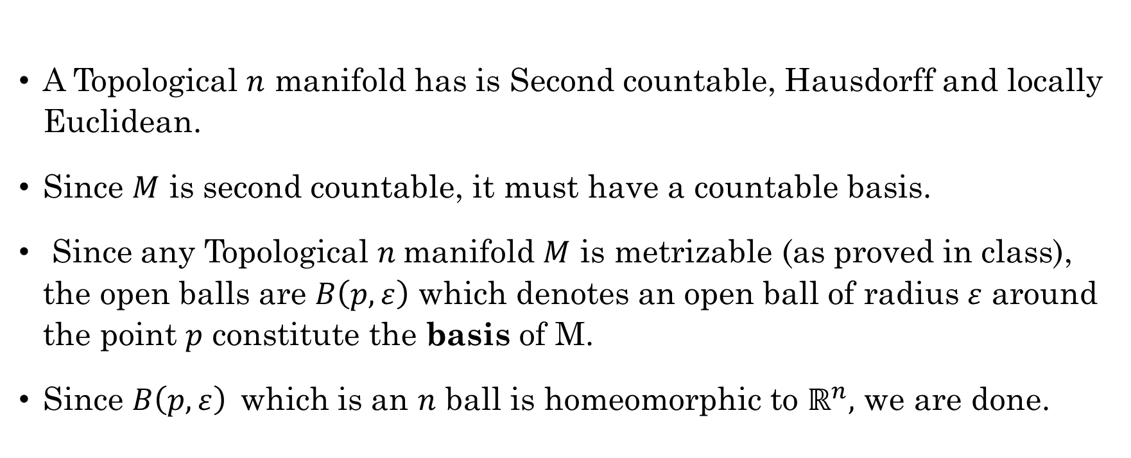
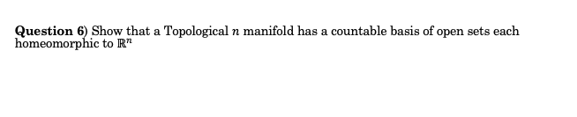
Question 6) Show that a Topological $n$ manifold has a countable basis of open sets each homeomorphic to $ℝ^{n}$
A Topological $n$ manifold has is Second countable, Hausdorff and locally Euclidean.
Since $M$ is second countable, it must have a countable basis.
Since any Topological $n$manifold $M$ is metrizable (as proved in class), the open balls are $B\left(p, ε\right)$ which denotes an open ball of radius $ε$ around the point $p$ constitute the basis of M.
Since $B\left(p, ε\right)$which is an $n$ ball is homeomorphic to $ℝ^{n},$ we are done.

Slide 3
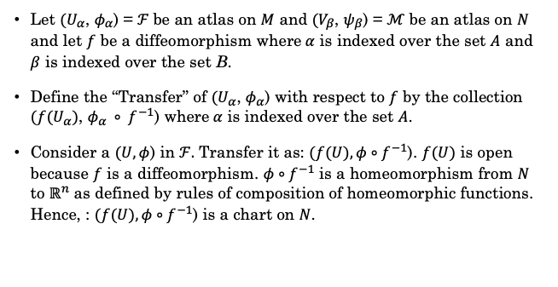
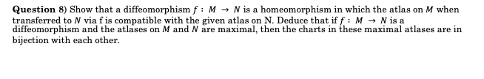
Question 8) Show that a diffeomorphism $f : M → N$ is a homeomorphism in which the atlas on $M$ when transferred to $N$ via f is compatible with the given atlas on N. Deduce that if $f : M → N$ is a diffeomorphism and the atlases on $M$ and $N$ are maximal, then the charts in these maximal atlases are in bijection with each other.
Let $(U_{α}$, $φ_{α}$) = $ℱ$be an atlas on $M$ and $(V_{β}$, $ψ_{β}$) = $ℳ$be an atlas on $N$ and let $f$ be a diffeomorphism where$α$ is indexed over the set $A$ and $β$ is indexed over the set B.
Define the “Transfer” of $(U_{α}$, $φ_{α}$) with respect to $f$ by the collection $({f(U}_{α})$, $φ_{α} ∘ f^{−1}$) where$α$ is indexed over the set $A$.
Consider a $(U, φ$) in $ℱ.$ Transfer it as: $(f(U), φ∘f^{−1}$). $f(U)$ is open because $f$ is a diffeomorphism. $φ∘f^{−1}$ is a homeomorphism from $N$ to $ℝ^{n}$ as defined by rules of composition of homeomorphic functions. Hence, : $(f(U), φ∘f^{−1}$) is a chart on $N$.

Slide 4
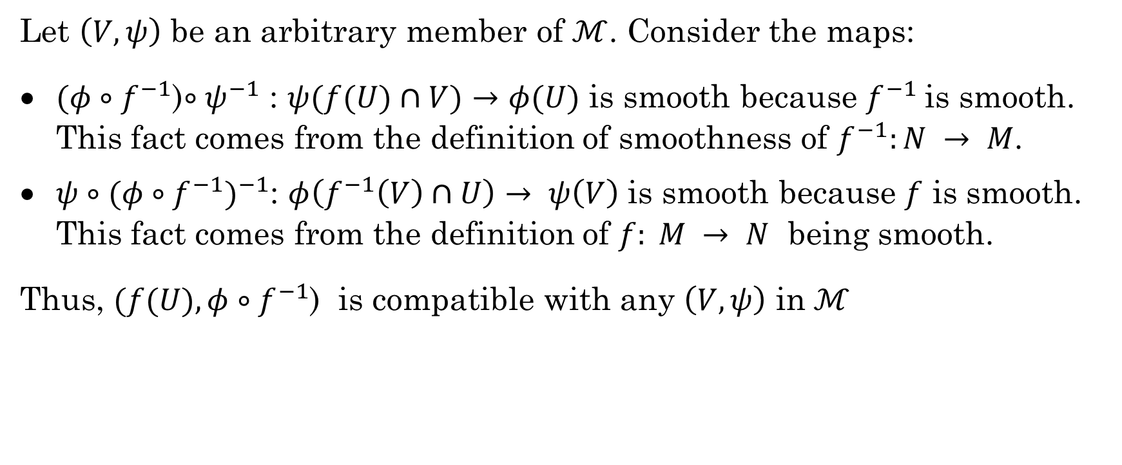
Checking Compatibility
Let $\left(V, ψ\right)$ be an arbitrary member of $ℳ$. Consider the maps:
$(φ∘f^{−1}$)$∘ψ^{−1}$ : $ψ(f(U)∩V)$ $→$ $φ(U)$ is smooth because $f^{−1}$is smooth. This fact comes from the definition of smoothness of $f^{−1}:N → M$.
$ψ∘{(φ∘f^{−1})}^{−1}$: $φ\left(f^{−1}\left(V\right)∩U\right)→ ψ\left(V\right)$ is smooth because $f$ is smooth. This fact comes from the definition of $f: M → N$ being smooth.
Thus, $(f(U), φ∘f^{−1}$) is compatible with any $\left(V, ψ\right)$ in $ℳ$

Slide 5
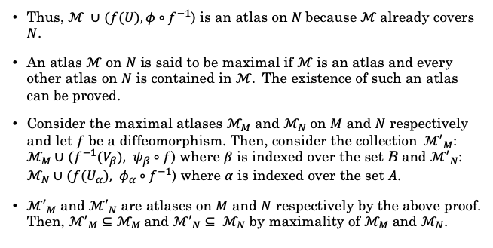
Question 8 (continued)
Thus, $ℳ ∪$ $(f(U), φ∘f^{−1}$) is an atlas on $N$because $ℳ$already covers $N$.
An atlas $ℳ$ on $N$ is said to be maximal if $ℳ$is an atlas and every other atlas on $N$ is contained in $ℳ.$ The existence of such an atlas can be proved.
Consider the maximal atlases $ℳ_{M}$ and $ℳ_{N}$ on $M$ and $N$ respectively and let $f$ be a diffeomorphism. Then, consider the collection${ℳ′}_{M}$: $ℳ_{M}∪$ $(f^{−1}(V_{β}), ψ_{β}∘f$) where $β$ is indexed over the set B and ${ℳ′}_{N}$: $ℳ_{N}∪$ $(f(U_{α}), φ_{α}∘f^{−1}$) where $α$ is indexed over the set $A$.
${ℳ′}_{M}$ and ${ℳ′}_{N}$ are atlases on $M$ and $N$ respectively by the above proof. Then, ${ℳ′}_{M}⊆$ $ℳ_{M}$and ${ℳ′}_{N}⊆ ℳ_{N}$ by maximality of $ℳ_{M}$ and $ℳ_{N}$.

Slide 6
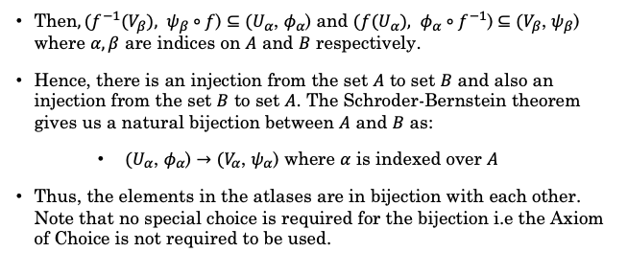
Question 8 (continued)
Then$, (f^{−1}(V_{β}), ψ_{β}∘f$) $⊆$ $(U_{α}$, $φ_{α}$) and $(f(U_{α}), φ_{α}∘f^{−1}$) $⊆$ $(V_{β}$, $ψ_{β}$) where $α, β$ are indices on $A$ and $B$ respectively.
Hence, there is an injection from the set $A$ to set $B$ and also an injection from the set $B$ to set $A$. The Schroder-Bernstein theorem gives us a natural bijection between $A$ and $B$ as:
$(U_{α}$, $φ_{α}$) $→$ $(V_{α}$, $ψ_{α}$) where $α$ is indexed over $A$
Thus, the elements in the atlases are in bijection with each other. Note that no special choice is required for the bijection i.e the Axiom of Choice is not required to be used.

Slide 7
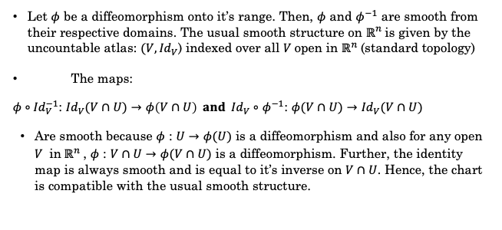
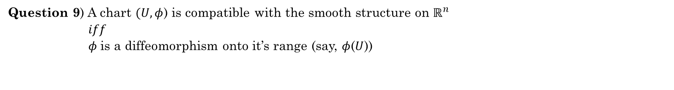
Question 9) A chart $(U, φ$) is compatible with the smooth structure on $ℝ^{n}$ $iff$ $φ$is a diffeomorphism onto it’s range (say, $φ$($U$))
Let $φ$ be a diffeomorphism onto it’s range. Then, $φ$ and $φ^{−1}$ are smooth from their respective domains. The usual smooth structure on $ℝ^{n}$is given by the uncountable atlas: $(V, {Id}_{V}$) indexed over all $V$open in $ℝ^{n}$(standard topology)
The maps:
$φ∘{Id}_{V}^{−1}$: ${Id}_{V}(V∩U)$ $→$ $φ\left(V∩U\right) and { Id}_{V}∘$ $φ^{−1}$: $φ(V∩U)$ $→$ ${Id}_{V}(V∩U)$
Are smooth because $φ$ : $U$ $→$ $φ(U)$ is a diffeomorphism and also for any open $V$ in$ℝ^{n}$, $φ$ : $V∩U$ $→$ $φ(V∩U)$ is a diffeomorphism. Further, the identity map is always smooth and is equal to it’s inverse on $V∩U$. Hence, the chart is compatible with the usual smooth structure.

Slide 8
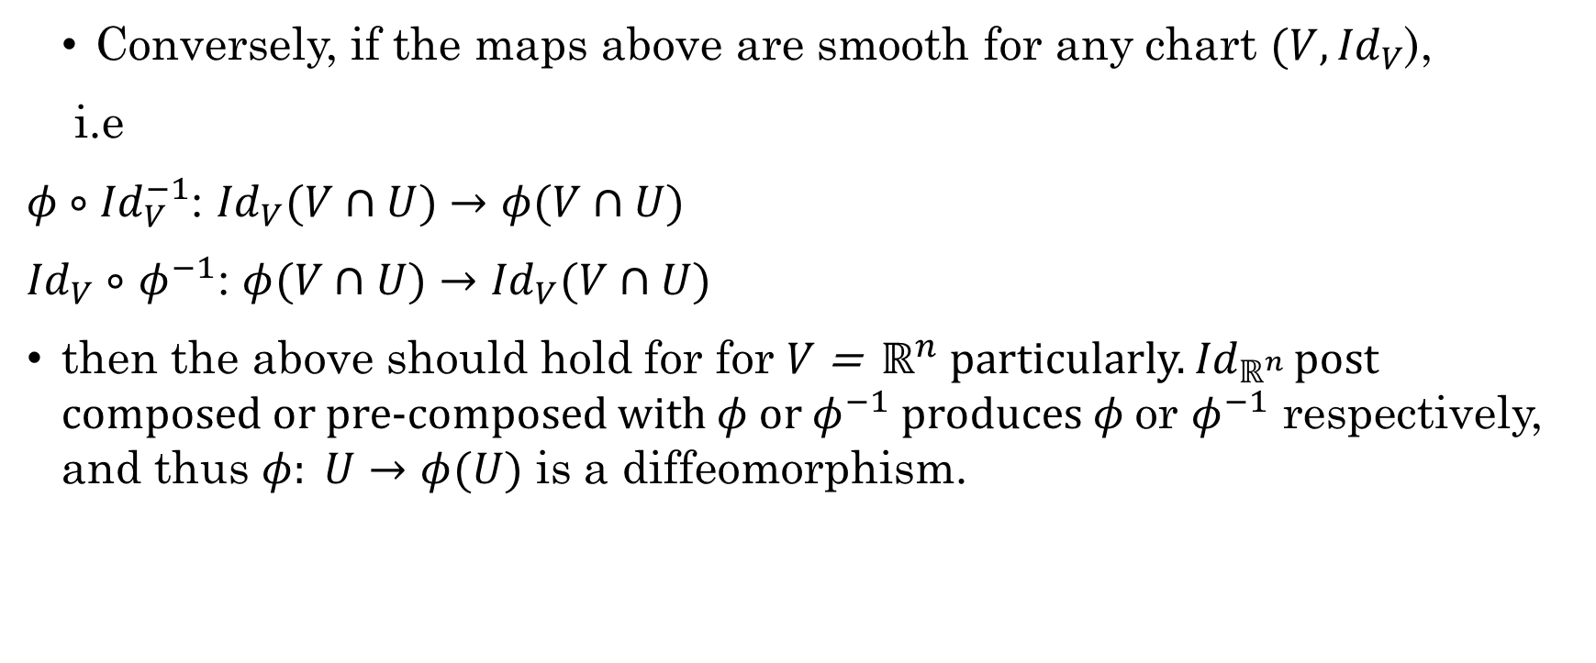
Question 9 (continued)
Conversely, if the maps above are smooth for any chart $(V, {Id}_{V}$),
i.e
$φ∘{Id}_{V}^{−1}$: ${Id}_{V}(V∩U)$ $→$ $φ(V∩U)$
${Id}_{V}∘$ $φ^{−1}$: $φ(V∩U)$ $→$ ${Id}_{V}(V∩U)$
then the above should hold for for $V$ = $ℝ^{n}$ particularly. ${Id}_{ℝ^{n} }$post composed or pre-composed with $φ$or $φ^{−1}$produces $φ$or $φ^{−1}$ respectively, and thus $φ: U$ $→$ $φ(U)$ is a diffeomorphism.

